Slide 1
Chemical Reactions

Slide 2
By the end of this lesson, you should be able to:
Explain what a chemical reaction is.

Slide 3
We call a chemical change a chemical reaction.
Reactions happen when one or more substances rearrange their particles into a different configuration. This creates a new substance.
We can represent this using a diagram:
reactants⟶products

Slide 4
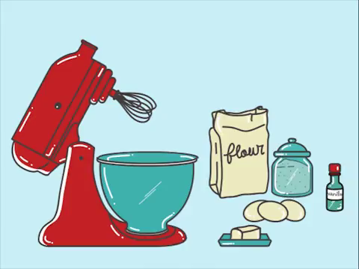
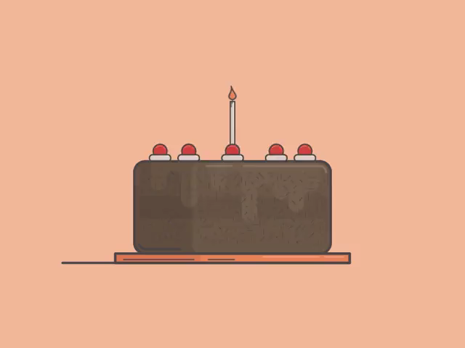
reactants⟶products
Reactants are the substances you begin with. When baking a cake, for example, cake batter is one of the reactants.
Products are the substances that are created. In this example, the finished cake is a product.
⟶

Slide 5
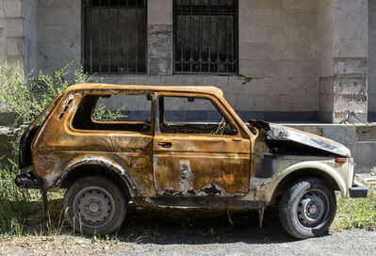
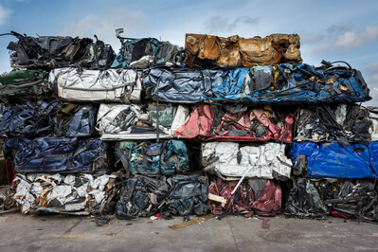
The reactants have to be chemically different from the products to make a chemical reaction.
For example, a rusting car is a reaction because rust is being created from iron, air and water.
A crushed car is not a chemical reaction because the chemicals making up the car do not change.

Slide 6
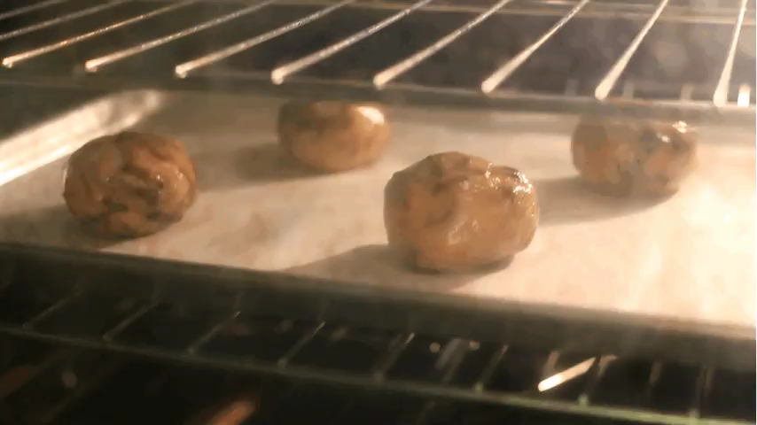
A chemical reaction cannot be reversed by physical means, and often cannot be reversed at all.
For example, if you bake a cookie (a chemical change), the cookie cannot be un-baked. It would take extraordinary means to reverse this change.
This is different from physical changes, which are always reversible. If water is frozen or boiled, it can be melted or condensed to return to a liquid.

